Slide 1
Chapter 7: Control Unit Operation

Slide 2
Functional Specifications of a Processor
  Operations
  Addressing Modes Defined by the Instruction Set
  Registers – user visible
  I/O Module Interface Defined by the System
  Memory Module Interface Bus Specification
  Interrupts Defined by System Bus Specification
  &
  Operating System Support
Execution Time Sequence of Instructions
is not necessarily the same as the
Written Sequence of Instructions in the Program
(branching instructions)

Slide 3
Micro-Operations
Instruction execution
  execution of a sequence of steps, i.e., cycles
Fetch, Indirect, Execute & Interrupt cycles
Cycle - a sequence of micro-operations
Micro-operations
  data transfer between registers
  transfer between a register & an external bus
  ALU operation

Slide 4
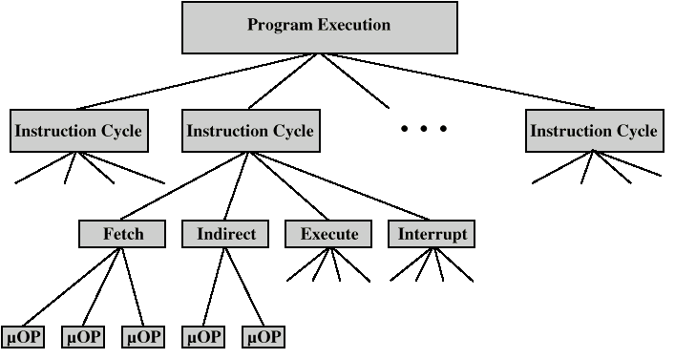
Constituent Elements of
Program Execution

Slide 5
Fetch Cycle

Slide 6
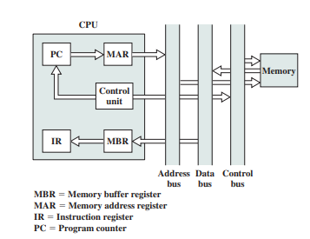
Fetch - 4 Registers
Memory Address Register (MAR)
  Connected to address lines of system bus
  Specifies address for read or write operation
Memory Buffer Register (MBR)
  Connected to data lines of system bus
  Holds data to write or last data read
Program Counter (PC)
  Holds address of next instruction
  to be fetched
Instruction Register (IR)
  Holds last instruction fetched.

Slide 7
Fetch Sequence
Address of next instruction is in PC
Address (MAR) is placed on address bus
Control unit issues READ command
Result (data from memory) appears on data bus
Data from data bus copied into MBR
PC incremented by 1 (in parallel with data fetch from memory) [micro-code RISC, length == 1]
Data (instruction) moved from MBR to IR
MBR is now free for further data fetches
Data flow,fetch cycle

Slide 8
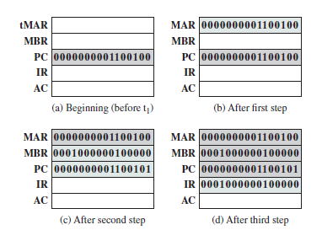

Fetch: Event Sequence (symbolic)
t1: MAR ← (PC); CU issues READ command
t2: MBR ← (memory) simultaneously
PC ← (PC) + I
t3: IR ← (MBR)
where tx refers to the time unit/clock cycle
------------------ or ------------------
t1: MAR ← (PC)
t2: MBR ← (memory)
t3: PC ← (PC) + I
IR ← (MBR)

Slide 9
Rules for Micro-Grouping
Proper sequence must be followed
  MAR ← (PC) must precede MBR ← (memory)
Conflicts must be avoided
  Must not read & write same register at same time
  MBR ← (memory) & IR ← (MBR) must not be in same cycle
Also: PC ← (PC) +I involves addition
  Must use ALU
  Hence, may need additional micro-operations

Slide 10
Indirect Cycle

Slide 11
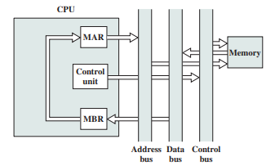
Indirect Cycle
Fetch Indirectly Addressed Source Operands
t1 : MAR ← (IR(address)) - indirect address field
t2 : MBR ← (memory)
t3 : IR(address)←(MBR(address)) - direct address field
MAR contains an indirect address
MBR contains a direct address
Result: IR is placed in same state as if direct addressing had been used originally
IR MUST BE LARGE ENOUGH TO HOLD ONE OR MORE DIRECT ADDRESSES
Data Flow, Indirect cycle

Slide 12
Interrupt Cycle

Slide 13
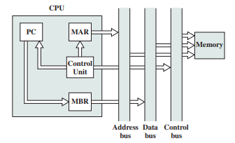
Interrupt Cycle – completion of the execute cycle
– test for interrupt occurrences -- process pending interrupts
t1: MBR ← (PC)
t2: MAR ← Save_Address for PC contents
PC ← address of start of interrupt processing routine,
  i.e., the interrupt Processing Routine_Address
  Multiple types and/or levels of interrupts, hence
  additional micro-operations may be required to obtain both
  Save_Address & Routine_Address
t3: memory←(MBR) - actual saving of the PC contents
Saving the context is done by interrupt handler routine, not micro-ops
Data Flow, Interrupt cycle

Slide 14
Execute Cycle
&
Instruction Decoding

Slide 15
Execute Cycle (ADD)
Different sequence of micro-operations for each instruction
ADD R1, X - add the contents of location X to Register 1 , place the result in R1
t1: MAR ← (IR(address(X)))
t2: MBR ← (Memory)
t3: R1 ← (R1) + (MBR)
Note: there is no overlap of micro-operations

Slide 16
Execute Cycle (ISZ)
ISZ X - increment and skip if zero
  t1: MAR ← (IR(address(x))
  t2: MBR ← (memory)
  t3: MBR ← (MBR) + 1
  t4: memory ← (MBR)
  if (MBR) == 0 then PC ← (PC) + 1
  test & action operation is one micro op
  performed during time unit t4

Slide 17
Execute Cycle (BSA)
– subroutine call instruction
BSA X - Branch and save address
  Address of instruction following BSA is saved in X;
  it will be used to return from the subroutine
  Execution continues from X+1
  t1: MAR ← (IR(address(X))
  MBR ← (PC) - address of next instruction
  in the sequence
  BSA X branches to X+1 after saving return address to location X
  t2: PC ← (IR(address(X))
  memory ← (MBR) - save PC contents in memory
  t3: PC ← (PC) + 1 - start processing from X+1
X : return address
X+1: start of subroutine
…
…
X+n: return from subroutine

Slide 18
Instruction Cycle
(Complete Picture)

Slide 19
Instruction Cycle
Each phase decomposed into sequence of elementary micro-operations
E.g. fetch, indirect, and interrupt cycles
Execute cycle
  One sequence of micro-operations for each opcode
Need to tie sequences together
Assume new 2-bit register
  Instruction cycle code (ICC) designates which part of cycle processor is in
    00: Fetch
    01: Indirect
    10: Execute
    11: Interrupt

Slide 20
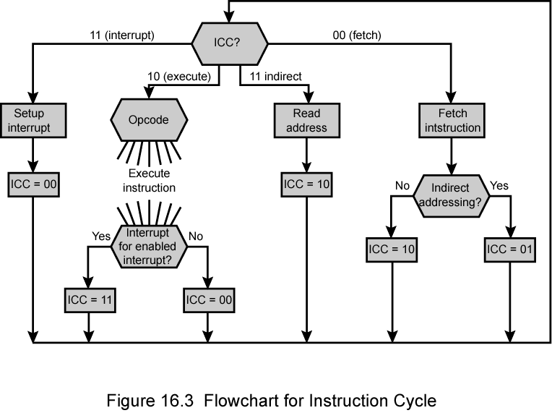
Flowchart for Instruction Cycle (Code)
Operation of the Processor ⬅➔ Performance of a Sequence of Micro-Operations
01
Indirect Cycle ➔ Execute Cycle ➔ next cycle depends upon the state of the system
Interrupt Cycle ➔ Fetch Cycle ➔ next cycle depends upon the state of the system

Slide 21
Control of the Processor

Slide 22
Control Unit - Functional Requirements
Define basic elements of processor
Describe micro-operations the processor performs
Determine functions control unit must perform to cause the micro-operations to be performed.

Slide 23
Basic Elements of Processor
ALU
Registers
Internal data paths – registers & ALU
External data paths
  registers – memory
  registers – I/O Modules
  registers – System Bus
Control Unit

Slide 24
Types of Micro-operation
Transfer data between registers
Transfer data from register to external interface
Transfer data from external interface to register
Perform arithmetic or logical operations using registers for I/O

Slide 25
Functions of Control Unit using Control Signals
Control Unit performs 2 basic tasks:
  Sequencing
    CU causes the CPU to step through a series of micro-operations in proper sequence based on the program being executed
  Execution
    CU causes each micro-operation to be performed
Control Signals
  External: inputs indicating the state of the system
  Internal: logic required to perform the sequencing and execution functions

Slide 26
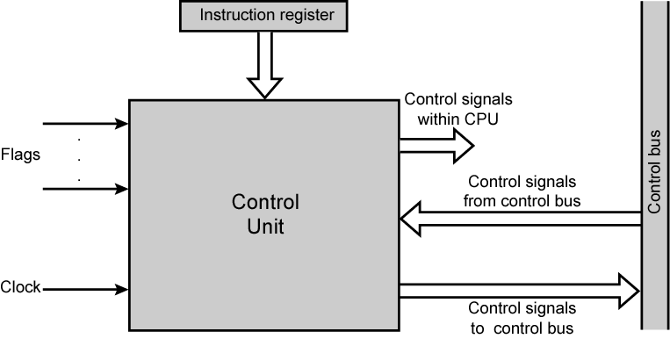
Model of Control Unit

Slide 27
Control Signals - input
  Clock (clock cycle time, processor cycle time)
  One micro-instruction (or set of parallel micro-instructions) per clock cycle
Instruction register
  Opcode & addressing mode for current instruction
  Determines which micro-instructions are performed
Flags – Used to determine the
  status of the CPU
  Results of previous ALU operations
Signals from the control bus part of the system bus
  Interrupts
  Acknowledgements

Slide 28
Control Signals - output
Control Signals within CPU
  Cause data movement register to register
  Activate specific ALU functions
  Activate a specific data path
Control Signals to the control bus
  To memory via the system bus
  To I/O modules

Slide 29
Control Signals
(Example)

Slide 30
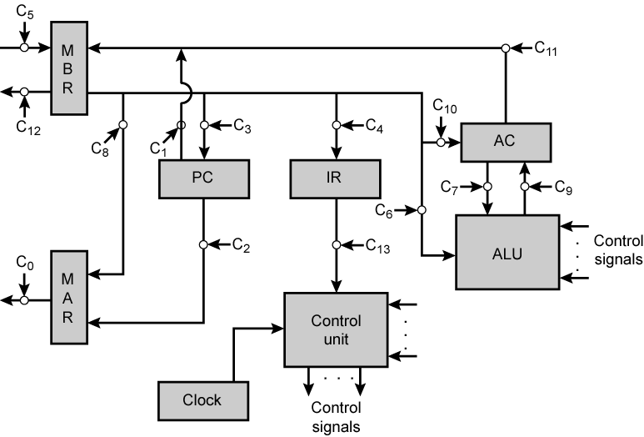
Data Paths and Control Signals
Flags
CU controls internal flow of data, operation of ALU, and access to the System Bus
CU uses the system clock to time the sequence of events & stabilize events

Slide 31
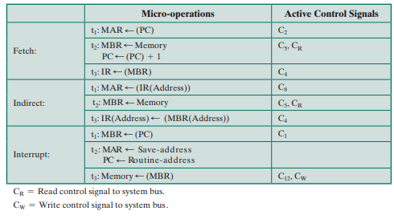
Micro-operations and Control Signals

Slide 32
Internal Processor Organization
(Single Internal Bus)

Slide 33
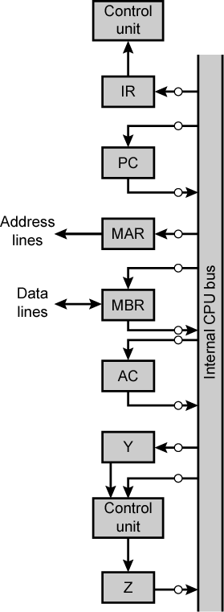
Internal Organization
Usually a single internal bus
Gates & Control signals control movement of data onto and off the bus from registers
Additional control signals: ALU & Bus
Temporary registers needed for proper operation of ALU
ALU

Slide 34
CPU with
Internal Bus
AC ← (AC) + (Memory)
t1: MAR ← (IR(address))
t2: MBR ← (Memory)
t3: Y ← (MBR)
t4: Z ← (AC) + (Y)
t5: AC ← (Z)
ALU is combinatorial unit with no internal storage; when it receives a signal, the input is immediately transformed into the output
One input to ALU comes directly from the Internal Bus, the other from the Y register
The output is caught and held by the Z register
ALU

